Slide 1
Human-Centered Poverty Reduction system design team
Sponsors:
David Stillman, Department of Social & Health Services
Diane Klontz, Department of Commerce
Maria Courogen, Washington State Department of Health
Tim Probst, Employment Security Department Washington State

Slide 2
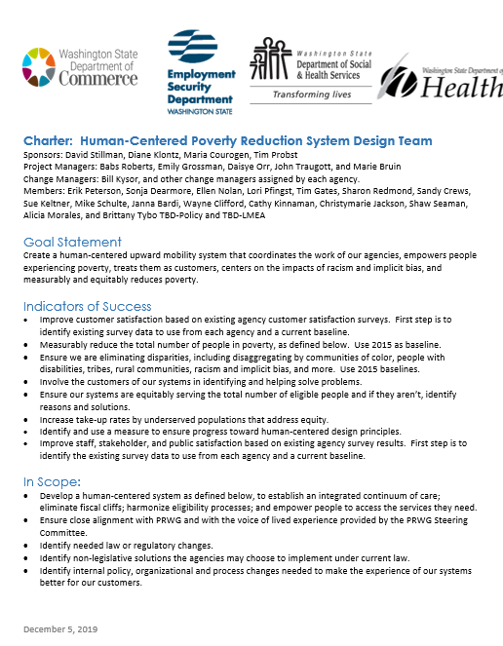
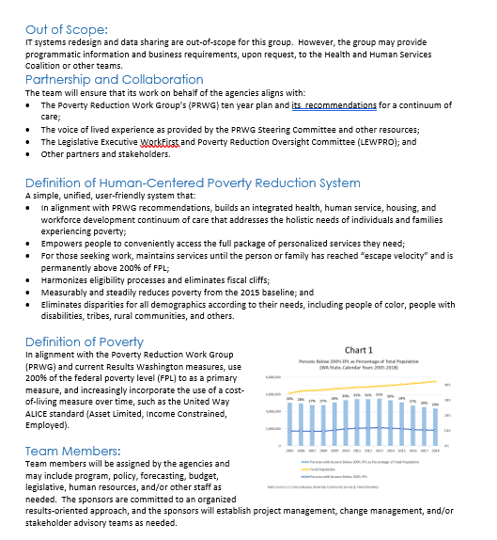
Project Managers:
Babs Roberts, DSHS
Emily Grossman, Commerce
Daisye Orr, DOH
John Traugott, and Marie Bruin, ESD

Slide 3
Goal Statement Create a human-centered upward mobility system that coordinates the work of our agencies, empowers people experiencing poverty, treats them as customers, centers on the impacts of racism and implicit bias, and measurably and equitably reduces poverty.

Slide 4
Team Purpose
Purpose:
This team is empowered to make recommendations about what our four agencies should begin working on together, to create a human-centered poverty reduction system. The Charter and the Poverty Reduction Work Group’s (PRWG) draft report provide a menu of recommended actions. You are empowered to recommend which of those items we should begin working on together.

Slide 5
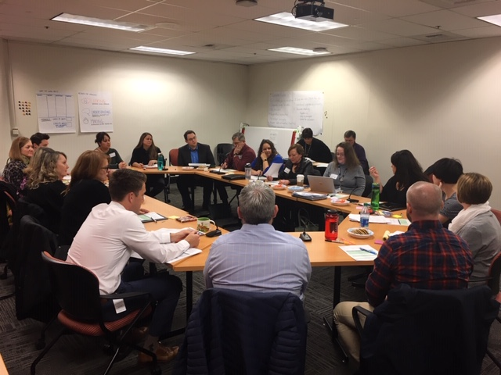
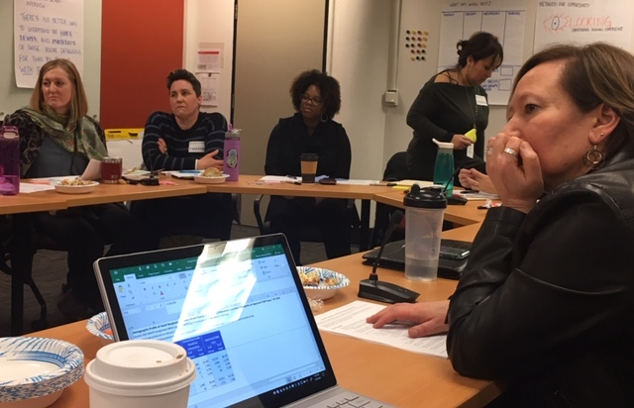
Kick off February 5th, 2020

Slide 6
Definition of poverty
In alignment with the Poverty Reduction Work Group (PRWG) and current Results Washington measures, use 200% of the federal poverty level (FPL) as a primary measure, and increasingly incorporate the use of a cost-of-living measure over time, such as the United Way ALICE standard (Asset Limited, Income Constrained, Employed).

Slide 7
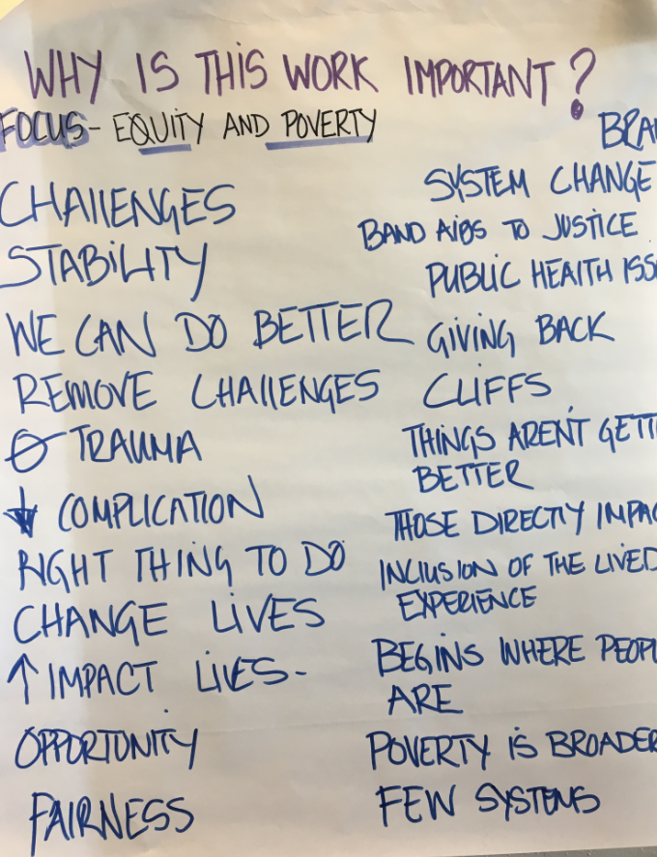
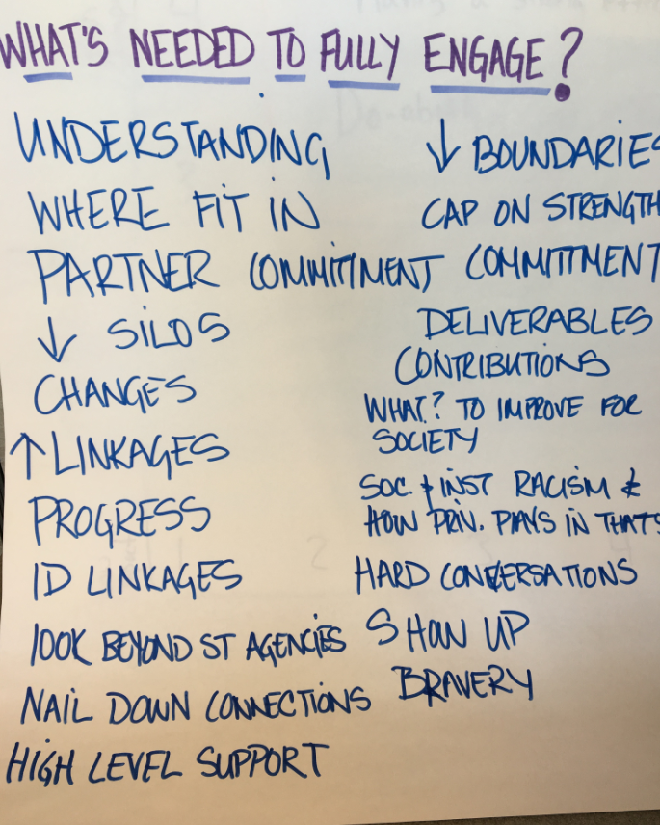

Slide 8
Indicators of success
Improve customer satisfaction
Measurably reduce the total number of people in poverty
Ensure we are eliminating disparities,
Involve the customers of our systems
Ensure our systems are equitably serving the total number of eligible people
Increase take-up rates
Measurably ensure progress toward human-centered design principles
Improve staff, stakeholder, and public satisfaction based on existing agency survey results
Notes:
Improve customer satisfaction based on existing agency customer satisfaction surveys. First step is to identify existing survey data to use from each agency and a current baseline.
Measurably reduce the total number of people in poverty, as defined below. Use 2015 as baseline.
Ensure we are eliminating disparities, including disaggregating by communities of color, people with disabilities, tribes, rural communities, racism and implicit bias, and more. Use 2015 baselines.
Involve the customers of our systems in identifying and helping solve problems.
Ensure our systems are equitably serving the total number of eligible people and if they aren’t, identify reasons and solutions.
Increase take-up rates by underserved populations that address equity.
Identify and use a measure to ensure progress toward human-centered design principles.
Improve staff, stakeholder, and public satisfaction based on existing agency survey results. First step is to identify the existing survey data to use from each agency and a current baseline.

Slide 9
Human-Centered Poverty Reduction System Design Team Roadmap
2020
Create a human-centered upward mobility system that coordinates the work of our agencies, empowers people experiencing poverty, treats them as customers, centers on the impacts of racism and implicit bias, and measurably and equitably reduces poverty.
Foundation:
Sponsors
Charter
Project Managers
Team members
Baseline:
Human-Centered
What do we know?
Voice of those impacted
Gap analysis
Strategy:
Criteria for priority
Short term goals
Longer term goals
Design/approach
Launch:
Design/approach
Pilot(s)
Policy changes
Legislative requests
Next steps:
TBD
00
01
02
03
04
05
06
07
08
09
10
11
12
Dec
Jan
Feb
Mar
Apr
May
Jun
Jul
Aug
Sep
Oct
Now
Dec
Start
Q1
Q2
Q3
Q4

Slide 10
Questions?
Marie Bruin
Employment Security Department
mbruin@esd.wa.gov

